Slide 1
WHO analysis
File created on: 12/30/2022 11:39:05 AM

Slide 2
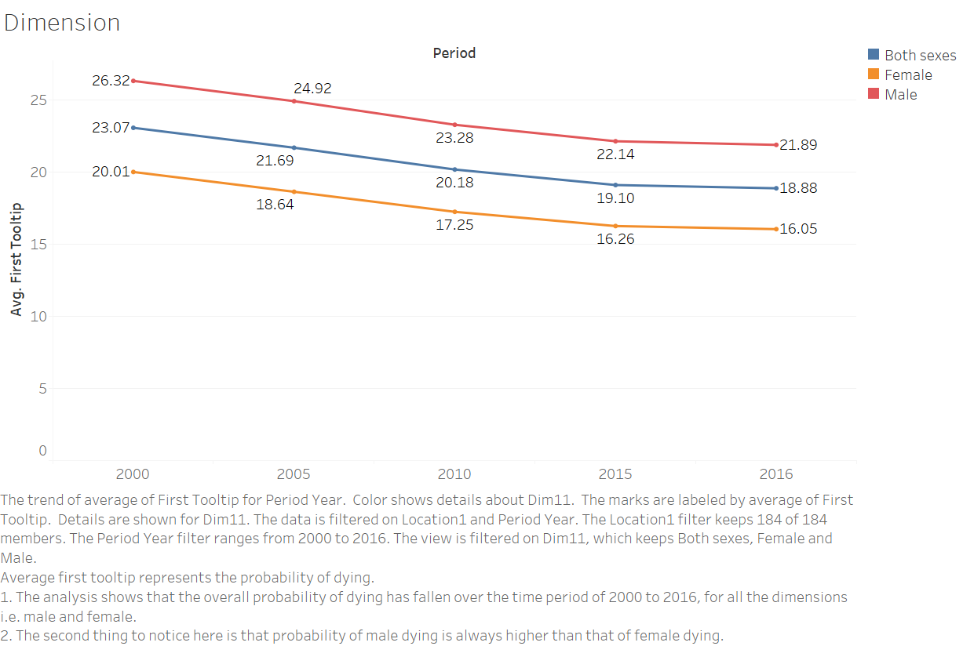

Slide 3
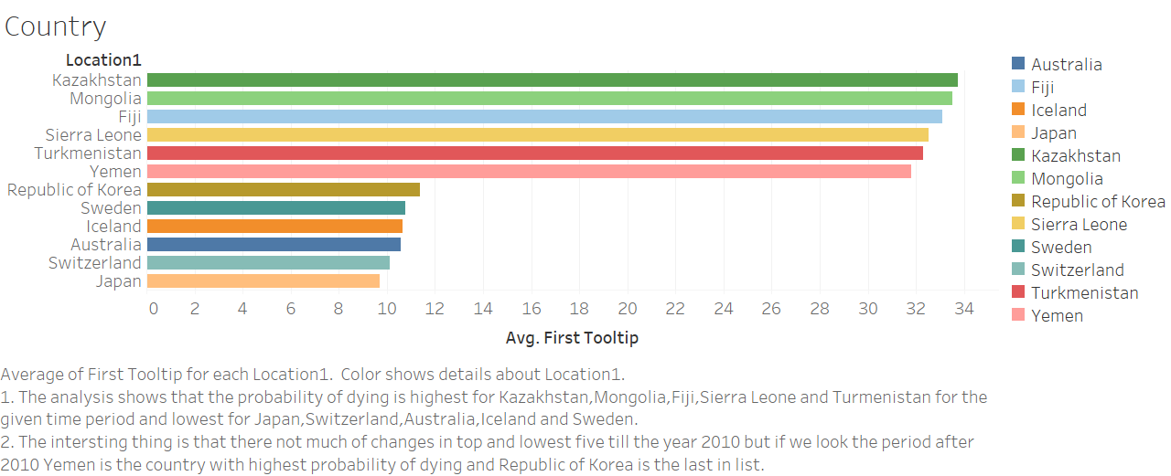

Slide 4
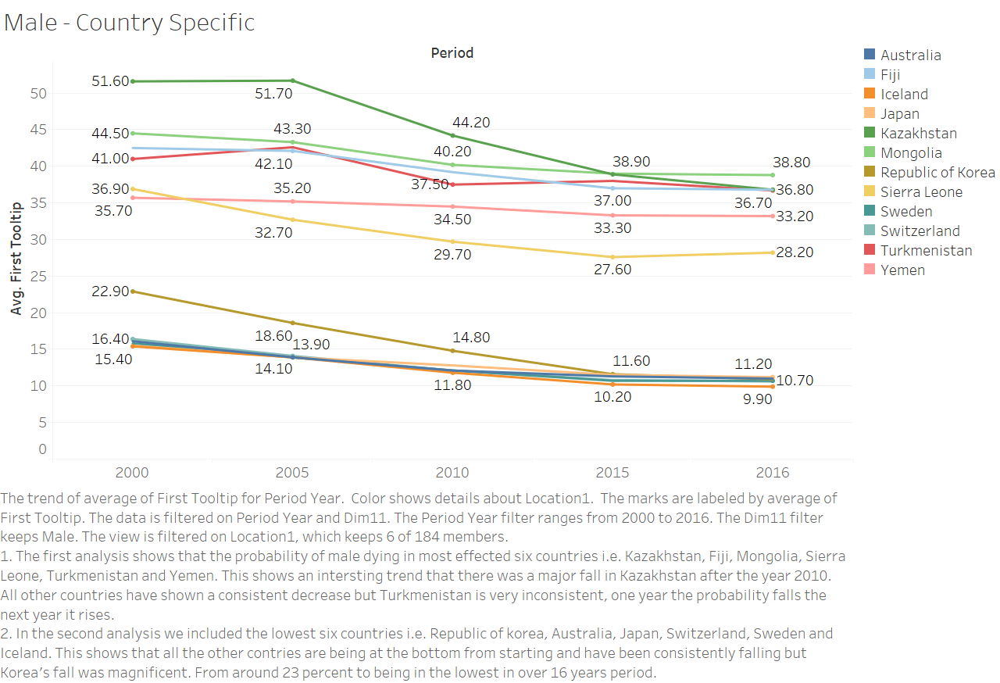

Slide 5
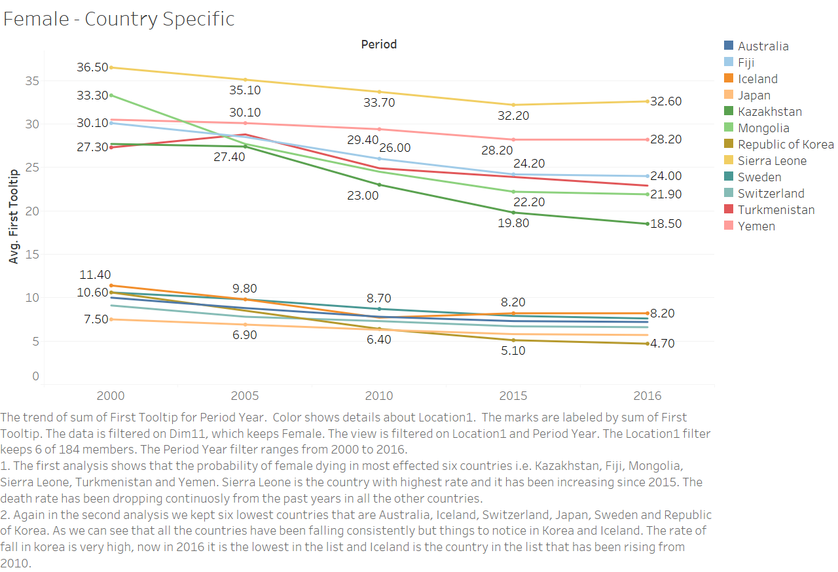

Slide 6
